Slide 1


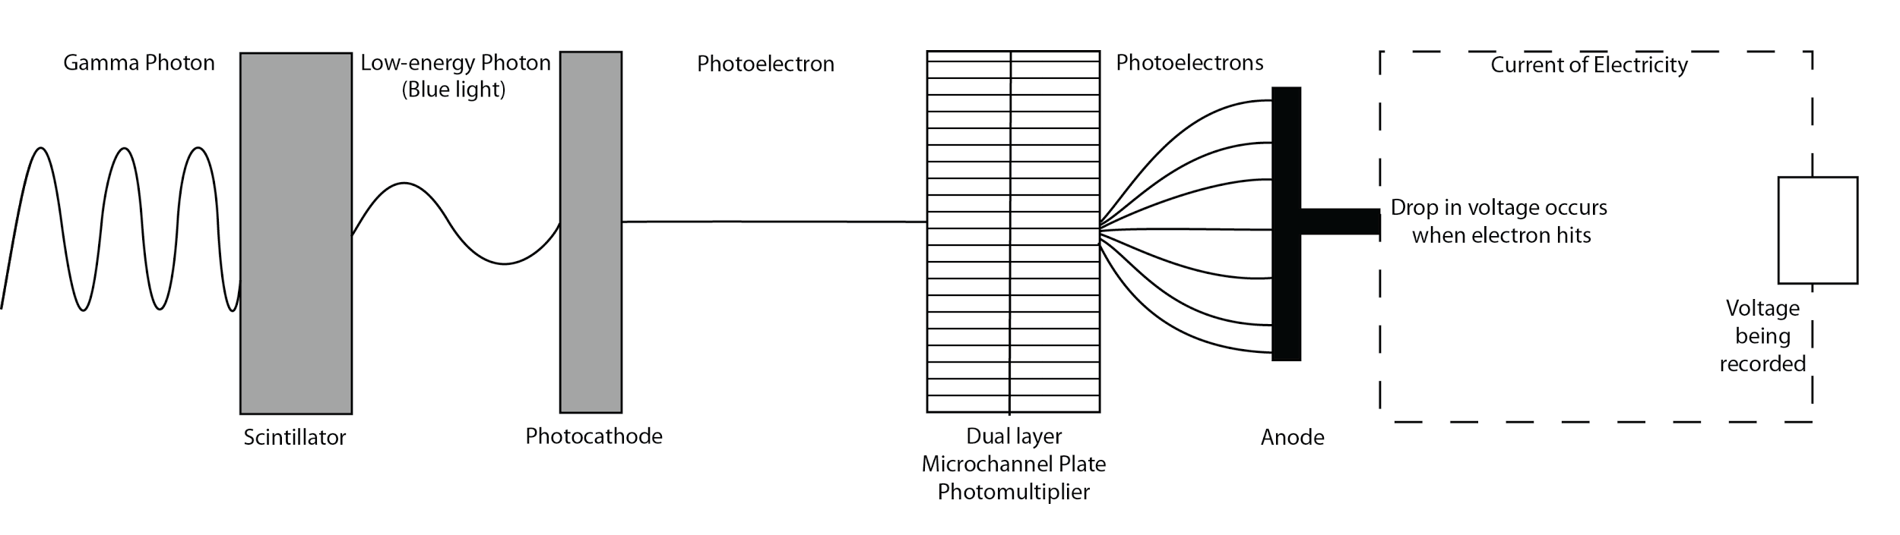
Is it possible to assess the sources of gamma radiation in
Low Earth Orbit using a CubeSat?
Seth Stoudenmier, Lucy Williamson, Paige Peck, Christopher Johnson, Stephen Frederico,
Dr. Cassandra Runyon, Dr. Jon Hakkila
Science Background
Gamma Radiation
Gamma radiation is the most energetic form of light, with wavelengths so small it can pass through most materials. Despite this, gamma radiation from outer space does not penetrate our atmosphere due to a process called Compton Scattering, which causes gamma radiation to be stopped in the stratosphere (10 to 50km).
Gamma rays have a high penetration range which can cause damage to living cells. While Beta particles are used in radiation therapy to kill cancer cells, gamma rays are often used for irradiation, the process of killing living organisms.
Gamma Ray Bursts (GRBs) and Solar Flares
GRBs are short-lived, but they are the most powerful explosions in the universe, releasing more energy in a second than the Sun will in its entire lifetime. Short GRBs (a few milliseconds - two seconds) are associated with black hole-neutron star mergers, while long GRBs (two seconds - several hundred seconds) are associated with the death of a massive star through a supernova explosion. Both the Swift and Fermi satellites measure about one burst per day, all of which have been outside the Milky Way, although a nearby GRB could be detrimental because it would strip the Earth’s ozone layer making it susceptible to the Sun’s radiation.
Solar flares occur when magnetic fields suddenly rearrange themselves, converting magnetic energy into light that is released and extends out to the corona. The burst of radiation ranges much of the electromagnetic spectrum. The frequency coincides with the Sun’s eleven year cycle. Solar flares are also often accompanied by a coronal mass ejection which throws plasma into space. They are classified into A, B, and C which don’t have much effect on the Earth, M, which generates brief radio blackouts at the poles, and X which are associated with coronal mass ejections and trigger widespread radio blackouts and long lasting radiation storms.
Instrumentation
The main instrumentation required for the project is a gamma ray detector (GRD), which has two main components: a scintillator and a photodetector. The chosen miniPlanacon Photodetector was selected for its small form (32x32x24mm) and wide spectral range (200-650nm). The BGO crystal scintillator was selected to pair with the photodetector because its emission spectrum (max 480nm) complements the spectral range. The crystal requires a thickness of 4mm to scintillate our focal energy ranges of 200keV.
Incident gamma photon strikes the scintillator to release a lower energy photon.
The lower energy photon enters the photocathode of the photodetector to produce a photoelectron.
The photoelectron strikes the photocathode to produce a photoelectron.
The photoelectron will pass through a photomultiplier to multiply the number of electrons.
These electrons will collide with anodes, generating an drop in voltage.
This drop in voltage will be recorded by and on board computer and will be proportional to the amount of gamma radiation detected.
Notes:
Paige: Chem.libretexts.org discusses radiation and its effects on matter: “Radiation either ionizes or excites atoms or molecules in living cells, leading to the dissociation of molecules within an organism.” DNA is affected by ionized radiation, and damage to DNA can cause genetic changes that can lead to birth defects and cancer.
Seth: The mission is composed of two scientific goals and five objectives to answer the question: Is it possible to assess the sources of gamma radiation in LEO using a CubeSat? These goals and objectives are split into threshold and baseline in the science traceability matrix (STM) shown on the reverse side. The threshold and baseline goals and objectives are above and below the bolded black lines in the STM.

Slide 2
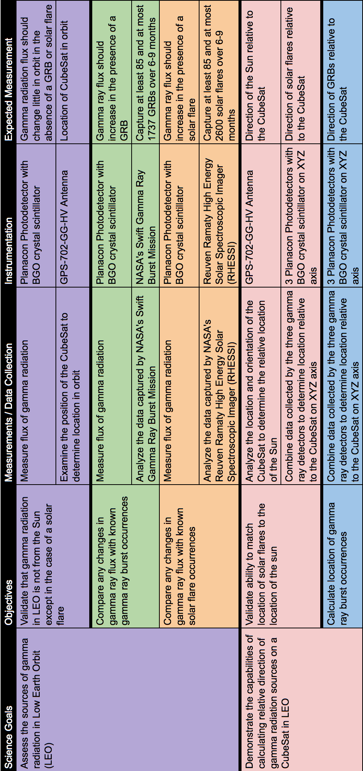
Definitions
Threshold - minimum results that are acceptable to consider the mission a success
Baseline - results that we believe to be achievable with the proposed mission
Notes
Black Lines are used to separate threshold (above) and baseline (below)
Purple is a threshold goal and within the threshold objective
Green and orange are a baseline objective within the threshold goal
Pink is a threshold objective within the baseline goal
Blue is a baseline objective within the baseline goal

